Slide 1
5. Profit and Stakeholders
Topic 1. What is a Business?
Chapter 1. Business Basics.
Unit 1. The Context of Business.
MXA101 – Introduction To Business
-By ManageX Academy

Slide 2
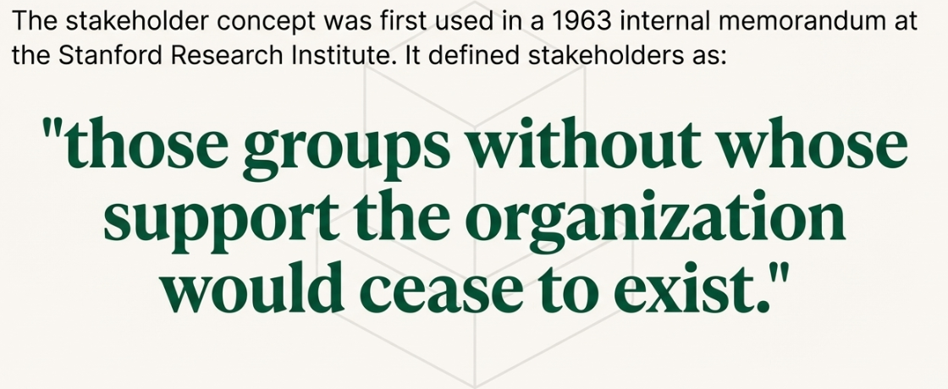
What is a Stakeholder?
Any individual or group with interest in the business
Can affect or be affected by business outcomes
Internal and external stakeholders
Essential for organizational success

Slide 3
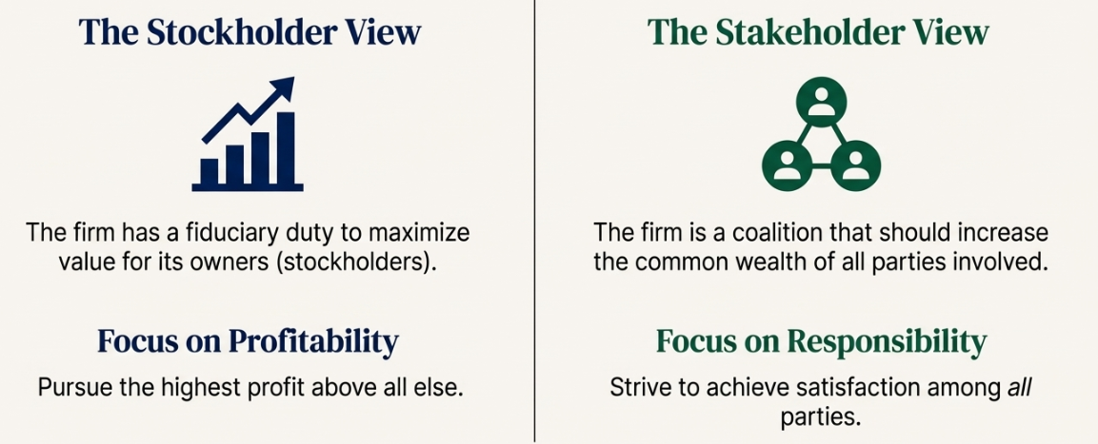
Stockholders vs Stakeholders
Stockholders are company owners
Stakeholders include all affected parties
Ownership vs interest
Profit vs responsibility

Slide 4
Fiduciary Duty Explained
Legal and ethical responsibility
Duty of trust and care
Managers act on behalf of owners
Focus on long-term value creation

Slide 5
Traditional Profit-Centered View
Focus on stockholders
Profit maximization priority
Limited stakeholder scope
Short-term performance driven

Slide 6
Stakeholder Theory – Modern View
Business serves multiple interests
Long-term sustainability focus
Balanced decision-making
Ethical and social responsibility

Slide 7
Who Are the Key Stakeholders?
Customers
Employees
Suppliers
Investors
Government
Community
Business partners

Slide 8
Even Competitors as Stakeholders?
Industry standards impact
Ethical competition
Market stability
Regulatory influence

Slide 9
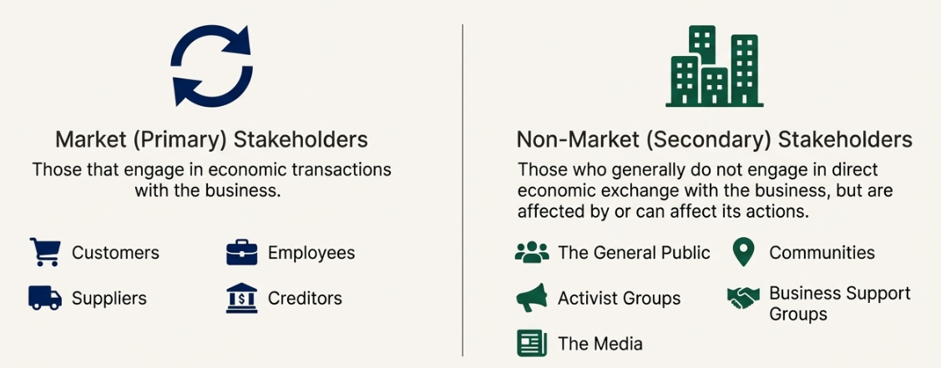
Market vs Non-Market Stakeholders
Market stakeholders: direct transactions
Customers, employees, suppliers
Non-market stakeholders: indirect impact
Community, media, activists

Slide 10
Stakeholders and Corporate Responsibility
Focus beyond profit
Ethical operations
Social responsibility
Sustainable growth

Slide 11
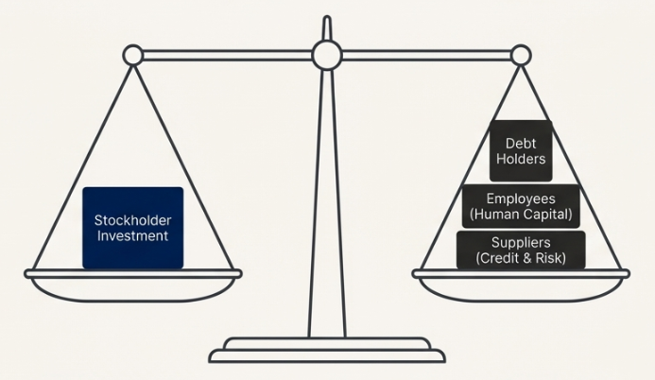
Profit vs Stakeholder Satisfaction
Short-term profit trade-offs
Long-term trust building
Reputation management
Risk reduction

Slide 12
Why Stakeholder Approach Creates Value
Strong brand image
Customer loyalty
Employee retention
Reduced legal and reputational risk

Slide 13
Real-Life Business Example
Employee welfare initiatives
Community engagement
Ethical sourcing
Long-term brand growth

Slide 14
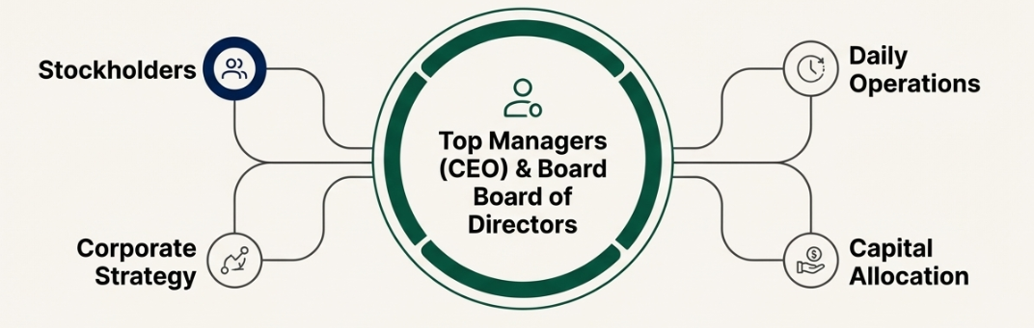
Stakeholders, Profit & Strategy
Strategic decision-making
Trade-off analysis
Long-term planning
Sustainable competitive advantage

Slide 15
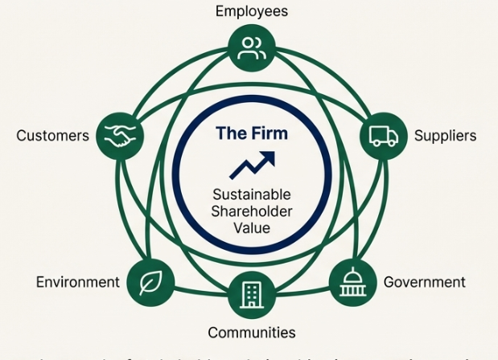
Key Takeaways
Stakeholders shape business success
Profit alone is not enough
Responsibility builds sustainability
Value comes from balance

Slide 16
Conclusion
Business is a stakeholder ecosystem
Long-term thinking wins
Learn management the right way

Slide 17


